Slide 1


Tips for dealing with complex problems
(and interacting with systems)
Dancing with systems
https://donellameadows.org/archives/dancing-with-systems/

Slide 2
Tips for interacting with systems and dealing with complex problems
1. Get into the rhythm
Observe how it works. Focus on its dynamics and structure. With reliable data.
Learn its history. Starting there helps to formulate useful questions.

Slide 3
Tips for interacting with systems and dealing with complex problems
2. Listen to the ‘wisdom’ of the system
Supports existing structures that help the system to function.E.g. Humanitarian aid.
3. Expose your mental models to the open air
Your knowledge of the system is nothing more than a simplified model of reality (Kant).
Collect as many visions as possible. This will help you to better understand what is going on.

Slide 4
Tips for interacting with systems and dealing with complex problems
4. Stay humble and learn
We learn by experimentation and from mistakes (embrace them).
No more insisting on staying the course.
Small steps and constant evaluation.
5. Information flow is key
Share your data, don't withhold information or distort it. E.g. US Pollution.

Slide 5
Tips for interacting with systems and dealing with complex problems
6. Places responsibility in the system
The system must have effective regulatory mechanisms.
Intrinsic accountability. Send clear and prompt feedback to decision-makers.

Slide 6


Tips for interacting with systems and dealing with complex problems
8. Seeks the good of the whole
Do not maximise parts of the system while ignoring the whole.

Slide 7
Tips for interacting with systems and dealing with complex problems
9. Broaden time horizons
Looking back in time helps to better understand the system.
Systems have memory

Slide 8
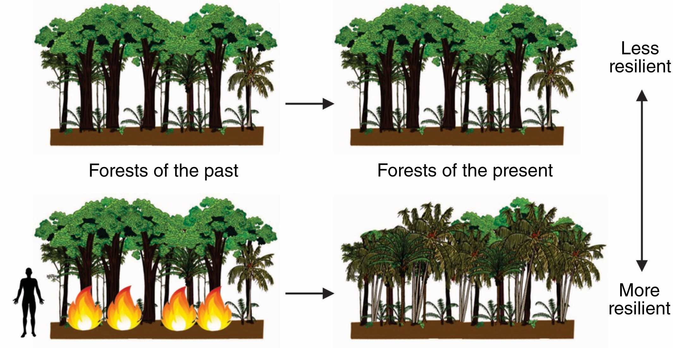
Tips for interacting with systems and dealing with complex problems
9. Amplía los horizontes temporales
https://besjournals.onlinelibrary.wiley.com/doi/10.1002/pan3.10510

Slide 9
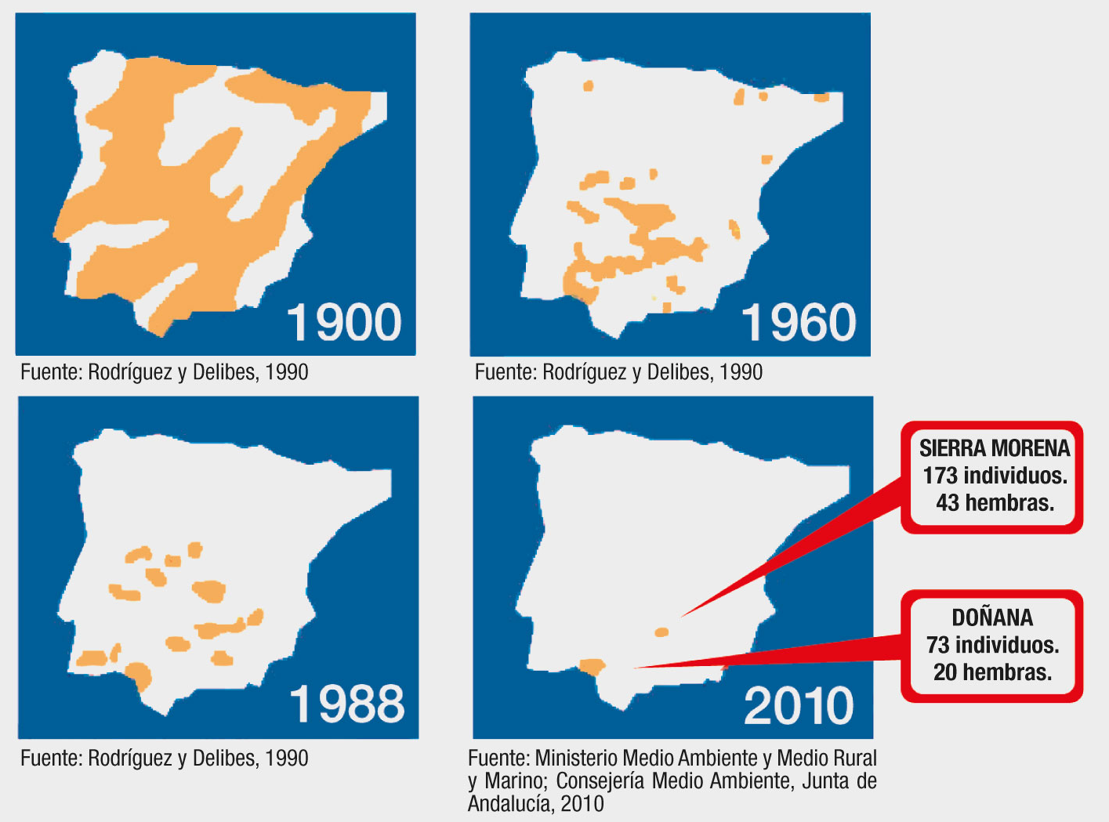

Tips for interacting with systems and dealing with complex problems
9. Broaden time horizons
Extinction debt

Slide 10
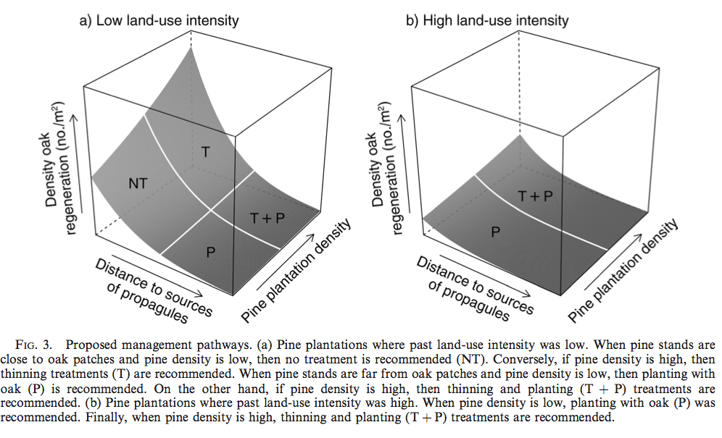
Tips for interacting with systems and dealing with complex problems
9. Broaden time horizons
Navarro-González et al. 2013. Ecological Applications. 23(6). 1267-1276

Slide 11
Tips for interacting with systems and dealing with complex problems
10. Broadens the horizons of thinking
Challenges the horizons of disciplines.
Listens empathetically and without judgement.
Learning attitude
11. Broadens the horizons of care
Strong relationships help solve problems.
Systems are based on interconnectedness

